Slide 1
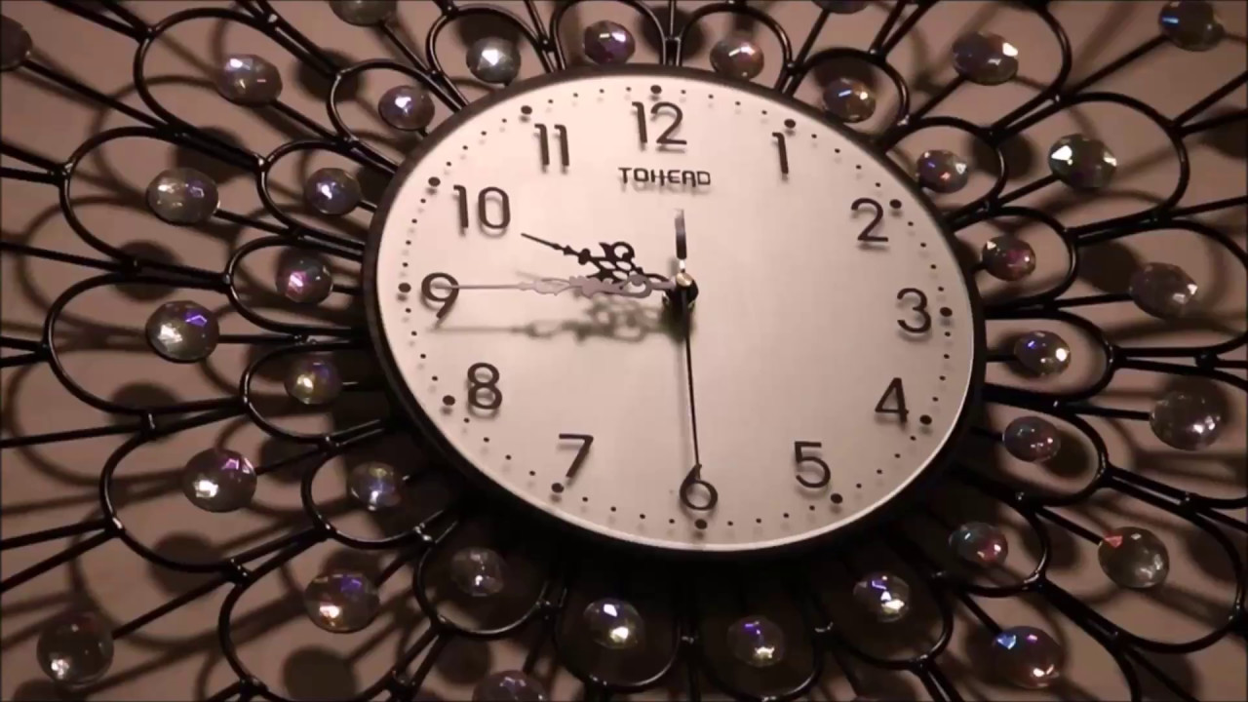

Slide 2
John Milton
"How Soon Hath Time"
Summary
Form and Structure
Meter
Rhyme Scheme
Themes
Detailed Analysis
Historical Context
Atheer Muhsin

Slide 3
"How Soon Hath Time"
How soon hath Time, the subtle thief of youth,
Stol'n on his wing my three and twentieth year!
My hasting days fly on with full career,
But my late spring no bud or blossom shew'th.
Perhaps my semblance might deceive the truth,
That I to manhood am arrived so near,
And inward ripeness doth much less appear,
That some more timely-happy spirits endu'th.
Yet be it less or more, or soon or slow,
It shall be still in strictest measure even
To that same lot, however mean or high,
Toward which Time leads me, and the will of Heaven;
All is, if I have grace to use it so,
As ever in my great Taskmaster's eye

Slide 4
Summary
How soon hath Time, the subtle thief of youth,
Stol'n on his wing my three and twentieth year!
My hasting days fly on with full career,
But my late spring no bud or blossom shew'th.
Perhaps my semblance might deceive the truth,
That I to manhood am arrived so near,
And inward ripeness doth much less appear,
That some more timely-happy spirits endu'th

Slide 5
Summary
Yet be it less or more, or soon or slow,
It shall be still in strictest measure ev'n
To that same lot, however mean or high,
Toward which Time leads me, and the will of Heav'n:
All is, if I have grace to use it so
As ever in my great Task-Master's eye.

Slide 6
Form and Structure
Petrarchan sonnet
The octave
The sestet
Line 9, is called the "turn" or the "volta."

Slide 7
Meter
1
How soon hath Time, the subtle thief of youth,
2
Stol'n on his wing
12
Toward which Time leads me, and the will of Heav'n:

Slide 8
Rhyme Scheme
1 How soon hath Time, the subtle thief of youth,
2 Stol'n on his wing my three-and-twentieth year!
3 My hasting days fly on with full career,
4 But my late spring no bud or blossom shew'th.
5 Perhaps my semblance might deceive the truth
6 That I to manhood am arriv'd so near;
7 And inward ripeness doth much less appear,
8 That some more timely-happy spirits endu'th.

Slide 9
9 Yet be it less or more, or soon or slow,
10 It shall be still in strictest measure ev'n
11 To that same lot, however mean or high,
12 Toward which Time leads me, and the will of Heav'n:
13 All is, if I have grace to use it so
14 As ever in my great Task-Master's eye.

Slide 10
Themes
Work, Ambition, and Aging
Faith, Grace, and Self-Surrender

Slide 11
Detailed Analysis

